Slide 1
PDA
Analysis and Recommendations

Slide 2

Table of Contents
Team Introduction
Features of PDA
Segments of the Market
Targeting
Limitations
Q&A
Notes:
Martin

Slide 3
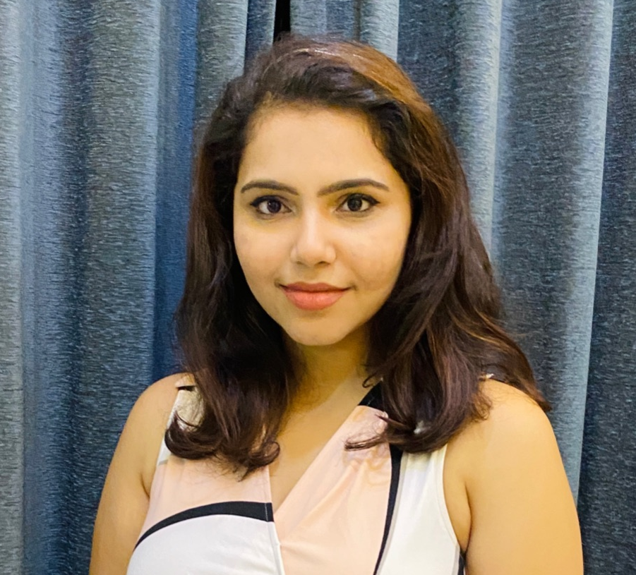

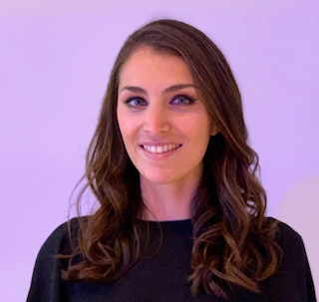



Team Introduction
Prachi Nerkar
GRADUATE STUDENT
MSBA
Palak Nath
GRADUATE STUDENT
MSBA
Maria Sol Cordero
GRADUATE STUDENT
MSTM
Parimal ikhar
GRADUATE STUDENT
MSTM
Aditya Bansal
GRADUATE STUDENT
MSBA
Tejas Dhomne
GRADUATE STUDENT
MSBA

Slide 4
Features of PDA

Slide 5
ConneCtor: Integrating PDA with cell phone
Opportunity
Competition
New
Product
Future
AT&T, Nokia and other cellular phone companies started developing
wireless phones with some
PDA functions.
In 1984 the first PDA with basic functions was made, by 2001, PDA's had evolved to have many applications, be
custom built for specific professions needs and further technological advancements included wireless technology
Conglomerate Inc, formed a
joint venture with a PC manufacturer Netlink t0 develop a Personal Digital Assistant (PDA) called ConneCtor
Making PDAs true
communication tools

Slide 6

Functional Attributes
Transmits Data
Transmits Voice
Backlit Touch Screen
Operating System
Wireless Sync
Instant Messaging
PIM Function
Cell Phone Functions
High Memory
Digital Voice Recorder
Voice Command
Email Communica
-tion
Internet Commucnica-tion

Slide 7
Trigger for the Analysis
The evolution of the PDA resulted in changes to different target market segments over time. Early users were usually high income, professional males over 30, typically working in technology and another group was mobile professionals who were a driving force behind wireless connectivity.
Despite efforts to bring mainstream buyers to the PDA market, the features were just too expensive and not refined enough for non business users to invest in the product large scale especially considering mainstream buyers had little need for many PDA functions.
Netlink developed criteria for target segment selection, and hired a market research firm, HVC, to gather information on ConneCtors customers and we are going to use this information in order to analyze and segment the market for the ConneCtor

Slide 8
Segments of the Market

Slide 9
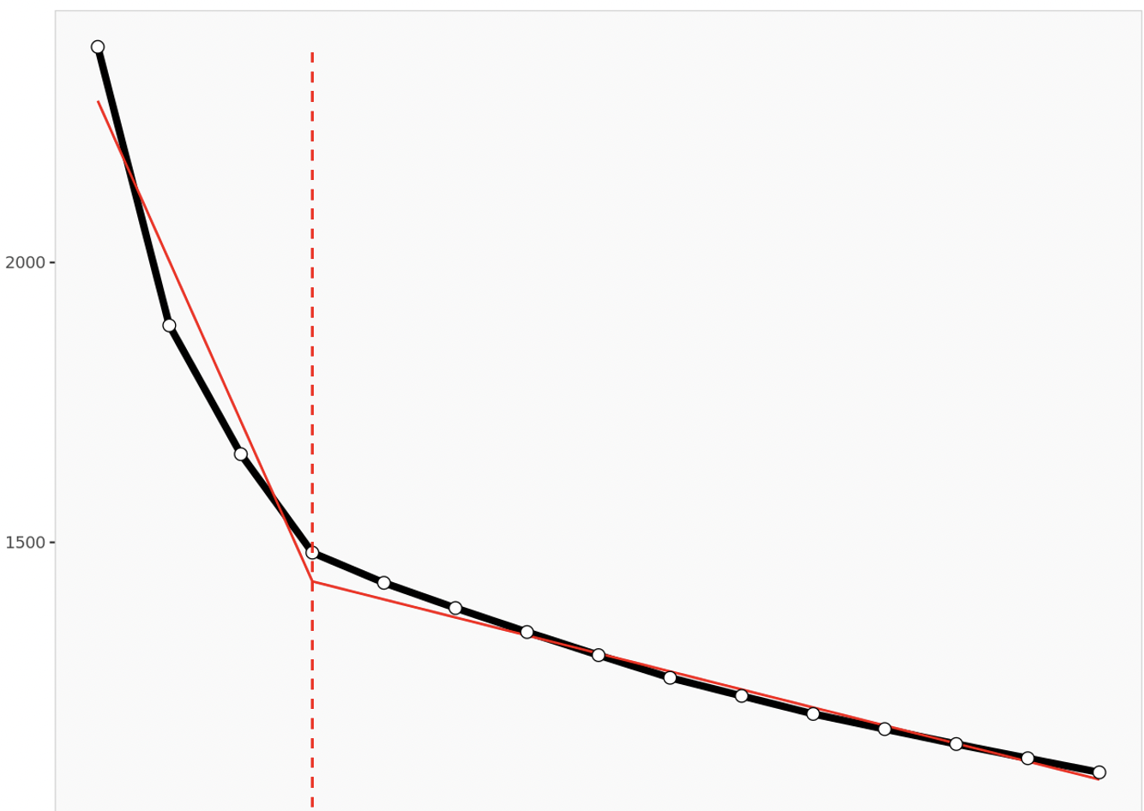
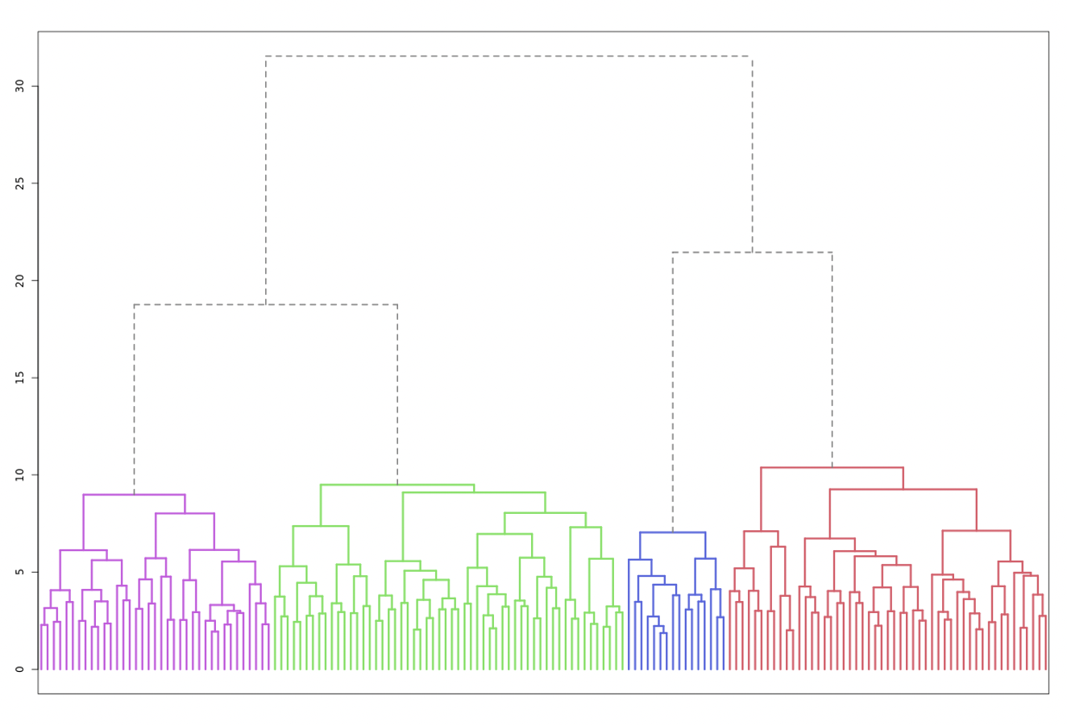
Using K means for Analysis
We use K means clustering for our analysis given its ease to compute clusters and its efficiency of handling large number of cases better than hierarchical clustering.
Looking at the dendogram and scree plot below, we can easily conclude that we can divide the population (160) into 4 clusters.

Slide 10
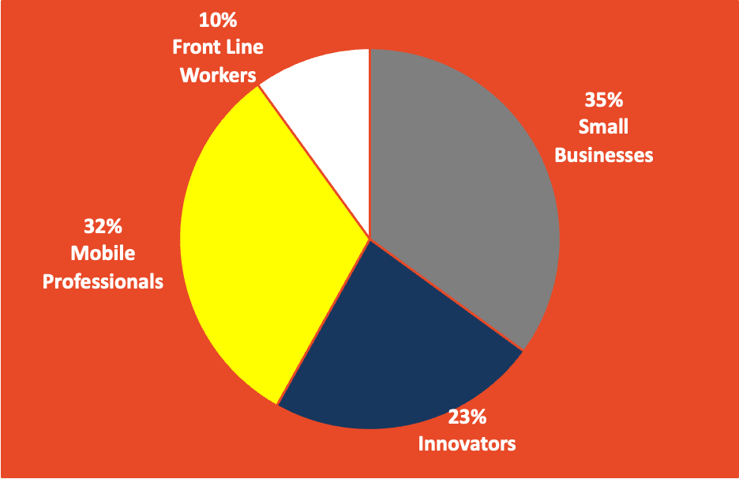
Segments of the Market
Based on lifestyle and business needs, the customers demanding PDA have been divided into 4 segments

Slide 11
Let’s Explore the characteristics of these 4 Segments
Segment 1 Small Business
56 customers
(35% of population)
Have high use of Personal Information Management tools such as schedulers, contact management tools and to do lists, need consistent access to email and the web for things such as stock prices or news and have relatively high use of multimedia features including playing games, video or music
Segment 2 Innovators
37 customers
(23% of population)
This price insensitive cluster is not hesitant to adopt new technologies and do not need to send and receive information They have the highest use for permanent web access and use of multimedia features and require a device that isn't bulky.
Segment 3 Mobile
Professionals
51 customers
(32% of population)
This cluster is sensitive to price and do not see themselves as innovators as they are hesitant to adopt new technologies. They have high use for instant messaging services but little use for Personal Information Management tools and need remote access to information. It is important for members of this cluster to view information on a large sized high resolution display but do not need permanent and constant access to email, the web and multimedia features
Segment 4 Front Line Workers
16 customers
(10% of population)
This segment is hesitant to adopt new technologies and do not commonly use messaging or use a mobile phone. They often send and receive time sensitive information, need remote access and is important for them to be able to share information rapidly with others. They don't need constant and permanent access to email or the web or use multimedia often, need a device that isn't bulky and are the least price sensitive cluster but would prefer pay a monthly price for services.
Notes:
Have high use of Personal Information Management tools such as schedulers, contact management tools and to do lists, need consistent access to email and the web for things such as stock prices or news and have relatively high use of multimedia features including playing games, video or music
non business users: could be teachers / not that technical / also for kids
take an example of each of the segment
segment 4: police officers / politicians- need information to be shared timely

Slide 12
Targeting

Slide 13
Basis of Targeting
We can evaluate the different segment attractiveness in terms of:
Size: The biggest segment is segment 1(small businesses), followed by segment 3(mobile professionals)), segment 2 (Innovators) and segment 4 (Front Line) which is the smallest segment
Growth: Segment 4 is small, but may have potential, as they are willing to pay for PDA`s with their features at a high price, on average, and most customers in this segment don`t own a PDA.
Competition: Large, high-growth segments may look attractive, but small businesses may find it difficult to compete with the large number of existing suppliers. So, must target segments keeping this in mind.
Segment Saturation: Segment 1 and 3 are slightly saturated ( a lot of people in this segment already own a PDA), but segment 4 in terms of saturation is the least crowded (not many own a PDA)
Fit: The best fit in features and needs is with segments 1 and 2
Relationships with other segments: Segments 1 and 2 overlap ( have similarities in many attributes)
Profitability: Segment 4 is willing to pay more for the features that ConneCtor offers.
Profitability
Size
Segment Saturation
Fit
Relationship with other segments
Competition
Growth
Notes:
Competitive strength is an important factor influencing marketing attractiveness. Large, high-growth segments may look attractive, but small businesses may find it difficult to compete with the large number of existing suppliers. New market entrants would have to make a major investment in marketing, particularly if customer loyalty was also high. In smaller niche segments, competitors are likely to be fewer because the costs and rewards for specialization are less attractive.

Slide 14

Recommended target:
Overall, we can conclude that the best segments to market should be Segment 1 (Small Businesses) and Segment 2 (Innovators),
Considering their attractiveness, segment 1 has a considerable size and segment 2 has the potential for growing.
Most features that these segments need and appreciate, are the ones that ConneCtor already has e.g. it directly transmits and receives both data and voice, has email and multimedia capabilities etc.
Although segment 1 is willing to pay less than average, we feel that with they will be right target as most of the features that they want are present in the ConneCtor.
By targeting both these segments, we will be able to target more than 50 % of the same which may ensure profitability
Also, we should not target segment 3 (mobile professionals), considering that “ConneCtor” is heavy (so it has a disadvantage in terms of portability) and that they are willing to pay the least, on average, for their main features
Lastly we also feel that targeting segment 4 is also a good idea as they are willing to pay the price. However many of the features that want are not present in “ConneCtor” and hence this is a long shot.
Notes:
Segment 1 (Innovators)
Age: They could focus on the groups of +40 years ( as both segments have, on average, that age or a little more) till 65 years ( This could be a starting point, to test this marketing strategy).
Education: Here, they should consider targeting people with higher education ( college degree)
Income: People with high income ( on average annual salary = $72.900)
Occupation: Working in sales
They should exclude those users who bought recently a PDA ( so they can focus on the segment who is unaware of this product and might be interested in it)
Promotions should appear for this group mainly in Business week media ( here, the higher proportion of investment, approx 60%), with a lower investment in PC magazines, and Modern Gourmet.
Segment 3 (Non-business):
Age: They could focus on the groups of +40 years ( as both segments have, on average, that age or a little more) till 65 years ( This could be a starting point, to test this marketing strategy).
Education: Here, they should consider targeting people with lower education ( High-School or some college)
Income: less than the average but a steady and good income, around $52.400 a year)
Occupation: Non-business and who may travel a lot and be away from home.
Promotions should appear for this group in PC magazine and Field and Stream media ( with a similar proportion: 45% for PC magazine and 55% for Field and Stream media).

Slide 15
Limitations

Slide 16
Limitations
Limitations of Analysis
Traits associated: honest, trendy, young, luxurious
We may be losing the opportunity of attending a very important segment of the market (mobile professionals).
Issue could be sampling bias or respondents overstating vs giving honest responses.
We might get a different result if we use another clustering method such as Ward’s method
The sample size is simply too small to represent the whole PDA market.

Slide 17
Limitations
Limitations of Analysis
Traits associated: honest, trendy, young, luxurious
Attribute ‘Price’ was on completely different scale. All attributes should have been normalised , to prevent price-sensitivity dominating, due to far larger value.
Issue could be sampling bias or respondents overstating vs giving honest responses.
Rapidly evolving market means any segment analysis can be changed year-by-year
New products could be released at any time, challenging existing competitors offering and market share.

Slide 18
Thank you! Questions?

